Slide 1
Iterative Model

Slide 2
Also called as incremental model
Project is break into small modules which can be delivered
A working version of the software is produced during the first module
Each subsequent release of the modules adds functionality to the previous release , the process continues till the complete system is achieved
This model is very successfully when working with new technology
More than one iteration can be going at the same time

Slide 3
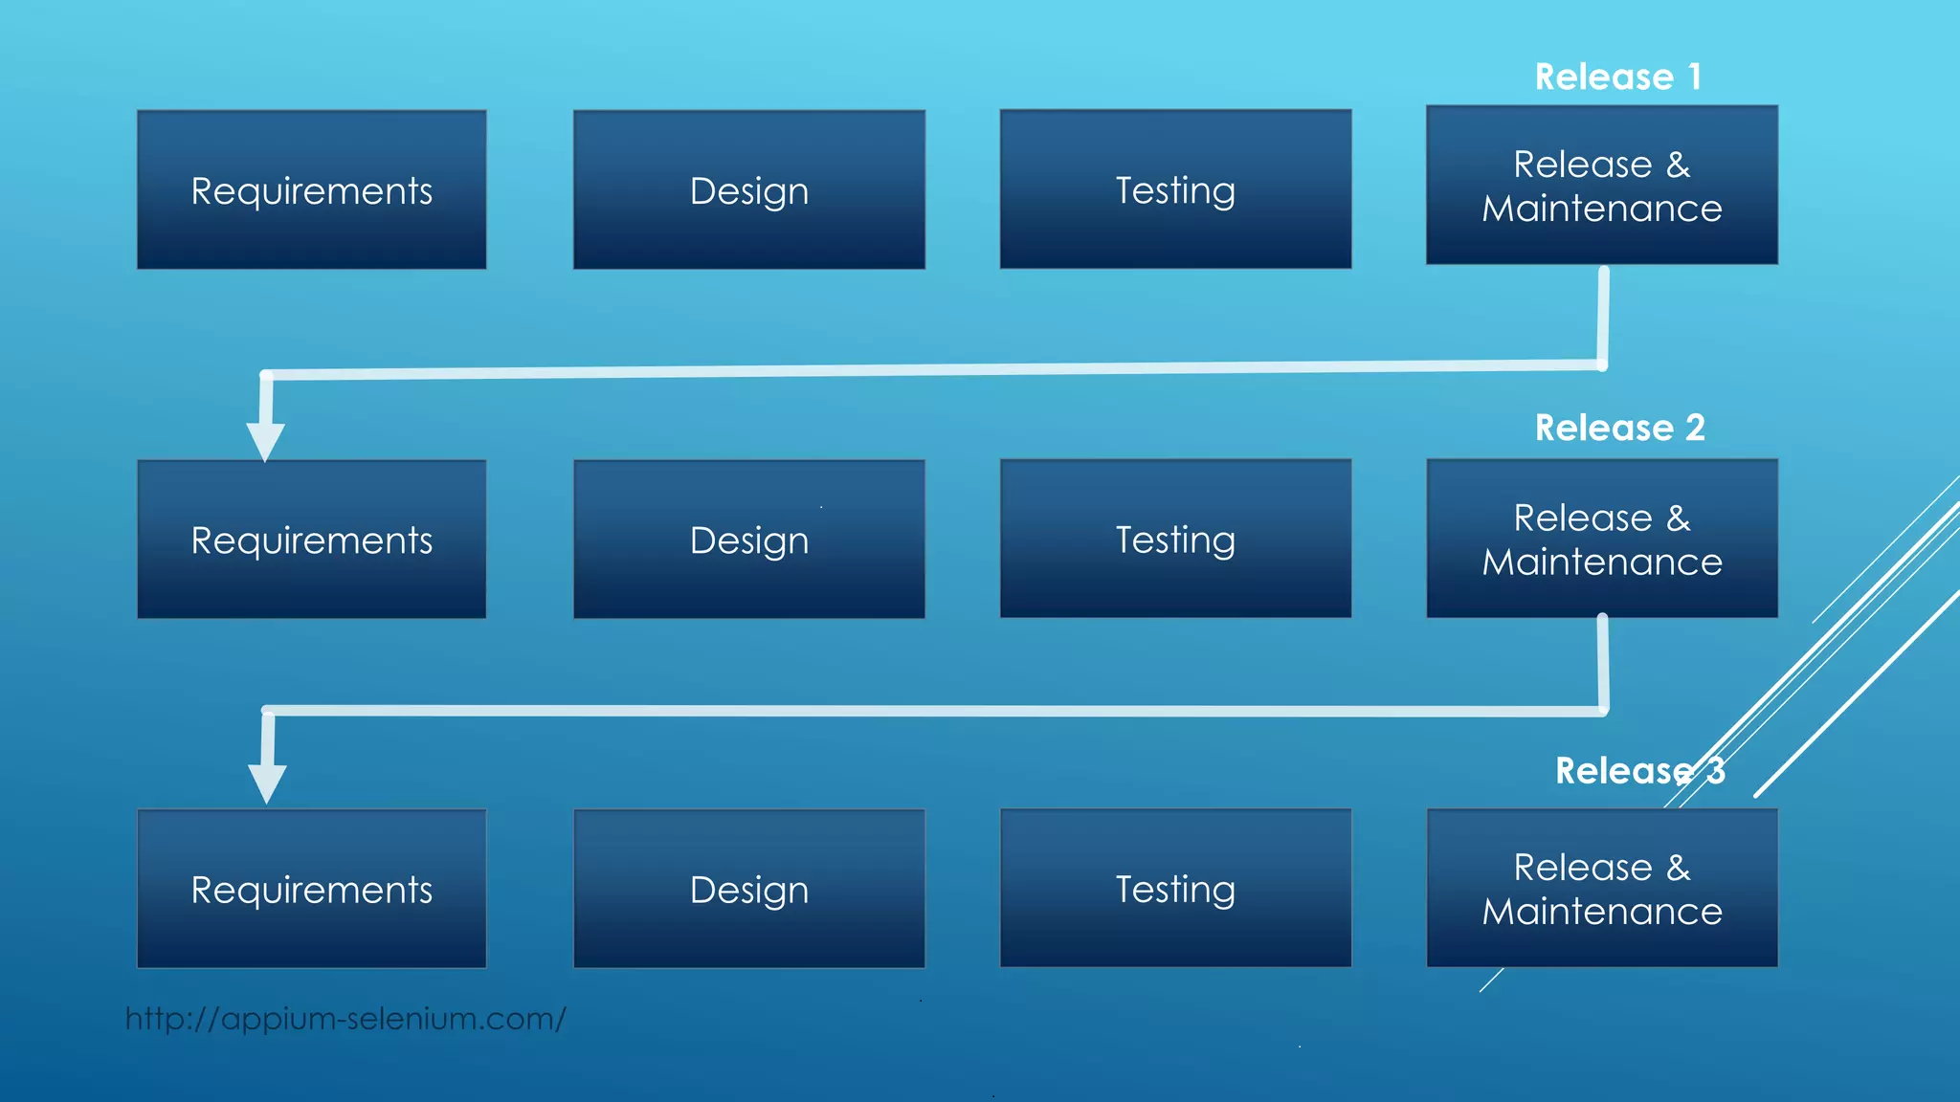

Slide 4
Advantages of iterative model
Quick software is released during the early phases of software life cycle
Less costly to change the requirements as compared to other models
Easier to develop and test when iterations are small
Customer can give feedback quickly
More than one iteration can be going parallel at the same time

Slide 5
Disadvantages of iterative model
Comparatively more rescores are required
Skilled manager is needed to manage otherwise costing is increased
Project started with complete project architecture design can result failures in future
Cost is higher than waterfall model

